Slide 1
INTELLIGENT MANHOLE MONITORING SYSTEM USING DATA MINING
MZ SCADA
TEAM GUIDE :
TEAM MEMBERS :
Mrs. D. ELAVARASI M.E.,Ph.D*.,
HEAD OF THE DEPARTMENT(CSE)
I. SATHIYA PRIYA - 911719104060
A. REEMA HAJRA - 911719104056
M. SELCIA - 911719104062

Slide 2
ABSTRACT
Drainage is the framework or procedure by which water, sewage or different fluids are depleted from a spot and to keep up the best possible capacity of waste, its condition ought to be checked consistently. In any case, physically it is exceptionally hard to screen all regions that a human can't reach. This impacts the blockage of underground funnels and floods of water causing the medical issue. additionally abstains from spreading of contamination because of mosquitoes and gives perfect and sound conditions just as controls the sickness. The operator interfaces which enable monitoring and the issuing of process commands, like controller set point changes, are handled through the SCADA computer system. the real-time control logic or controller calculations, are performed by networked modules connected to the field sensors and actuators.

Slide 3
DOMAIN - FLUTTER (FIREBASE DB)
Flutter provides a powerful and efficient framework for developing SCADA tools, combining cross-platform compatibility, performance, flexibility, and a rich set of UI components to create modern and feature-rich applications.
Cross-Platform Development
Native-Like Performance
Hot Reload
Rich UI and Customization
Responsive Layouts
Integration Capabilities
Community and Third-Party Packages
Cost-Effectiveness

Slide 4
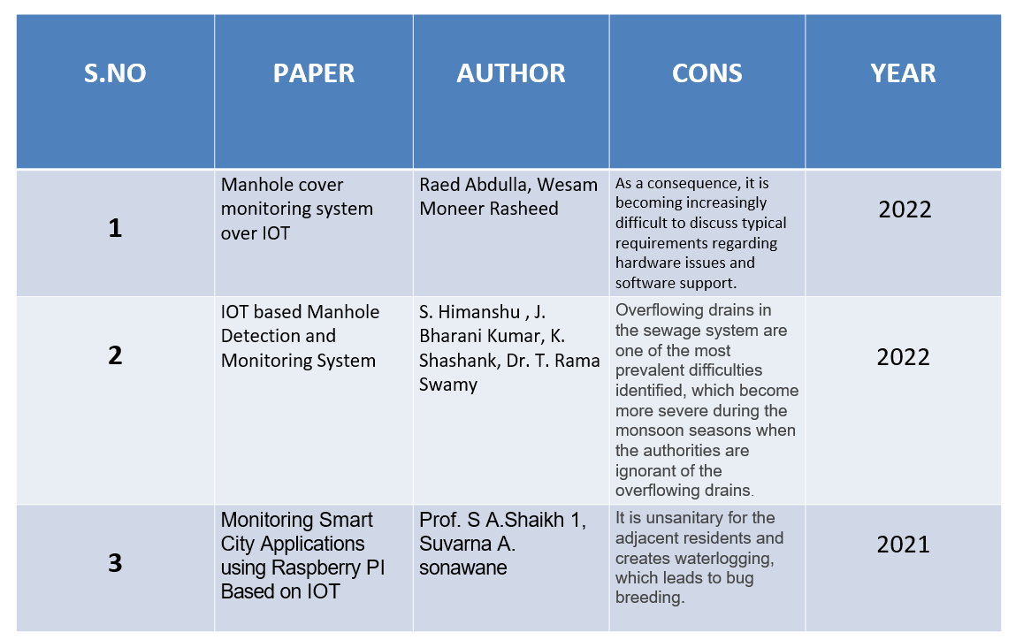
LITERATURE SURVEY

Slide 5
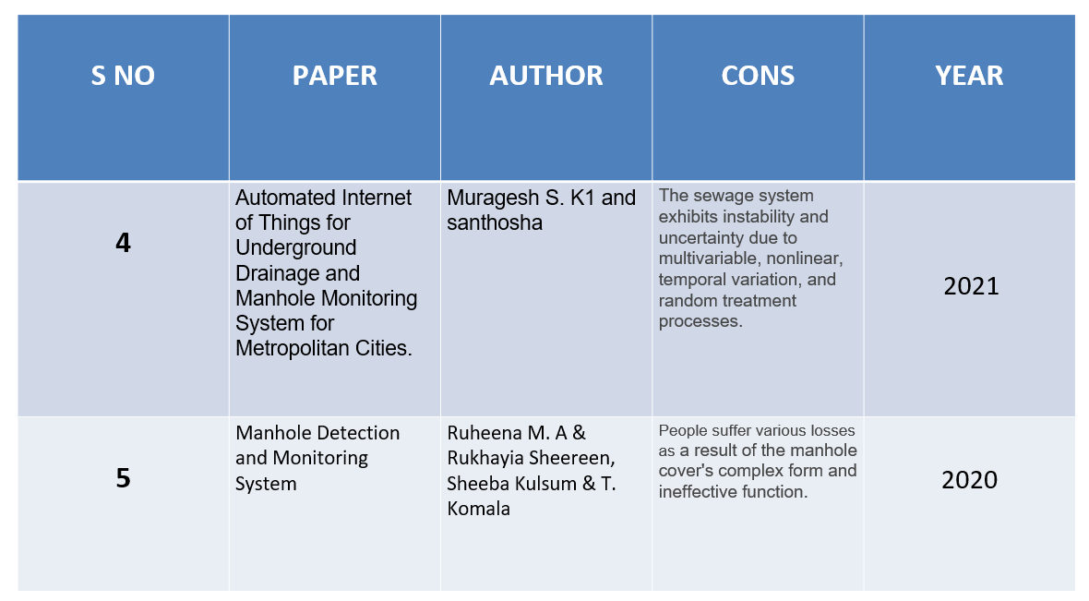
LITERATURE SURVEY

Slide 6
EXISTING SYSTEM
Manual Monitoring:
The biggest disadvantage is that the person can’t know it before hand and This could lead to problem such as overflowing of water and result in water wastage
Acoustic Leak Detection:
Numerous filters and algorithms can be used to analyze this disturbance and distinguish it from other pressure events on the pipeline.
Correlate Leak Detection:
If the distance between the sensors is known in advance, this timing information can be used to determine the location of the leak.
Ground Penetrating Radar:
When the energy encounters a buried item or a boundary between materials having different permittivity, it may be scattered back to the surface. 3.1.5 Pressure/Flow monitoring:
It is only useful in steady-state conditions, however, and its ability to deal with gas pipelines is limited.

Slide 7
DISADVANTAGES
Lacking of availability.
Costly.
Manual monitoring system.
Labor & labor cost.
Inefficient.
Lack of automation.

Slide 8
PROPOSED SYSTEM
Our MZ SCADA proposes the following features.
Detects the specific drain where the blockage occurs.
Detects toxic gas levels that would be harmful.
The system governs the flow of sewage from the pipes.
Finds out open vents to intimate, thus prevents accident.
Get the prior alerts of blockages and locate them using data mining.
It provides graphical demonstration of the alert

Slide 9
ADVANTAGES
Easy visualization
Automated monitoring system.
Cost efficient.
No labor cost.
Efficient.
Alert system with logs.
Real time SCADA tool.

Slide 10
MODULE SPLIT UP
1.DATA LOGGING: This module involves data gathering from each individual sensors that are involved in the proposed system. Thus all the sensor values are gathered in the initial state.
2.DATA COMMUNICATION: The gathered data are then communicated with to the cloud via GSM module. The communication happens very frequently such that values are updated very instantly in the firebase.

Slide 11
MODULE SPLIT UP
3.INTERPRETATION: Interpretation refers the analysis that takes place to find out whether the sensor value increases more than the set value, this is the most important module which is responsible to update an notify any failure that happens.
4.NOTIFICATION: The final module brings the result the phase where upon their interpreted value the system send a notification to the mobile app as well as an sms service is provided to the working men in the particular region.

Slide 12
METHODOLOGY
BEHAVIORAL-BASED ALGORITHM:
Behavioral research helps predict, prevent, and manage flaws in SCADA system. This research also helps people change their behaviors, understand alerts and learn how overcome them.
Data Acquisition
Data Processing
Visualization
Control and Automation
Alert Management
Security
Data Storage and Historization

Slide 13
SOFTWARE REQUIREMENTS
MODBUS SIMULATOR:
Modbus is a communication protocol widely used in industrial automation to communicate between electronic devices. A Modbus Simulator is a software tool that can simulate a Modbus.
FIREBASE:
Features of Firebase include:
Real-time database
Cloud storage
Authentication
Analytics
Cloud messaging (Notification)
Hosting

Slide 14
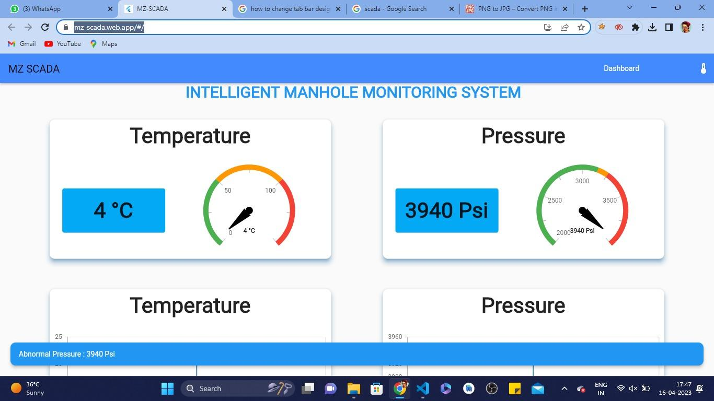
RESULTS - MZ SCADA HOME PAGE

Slide 15
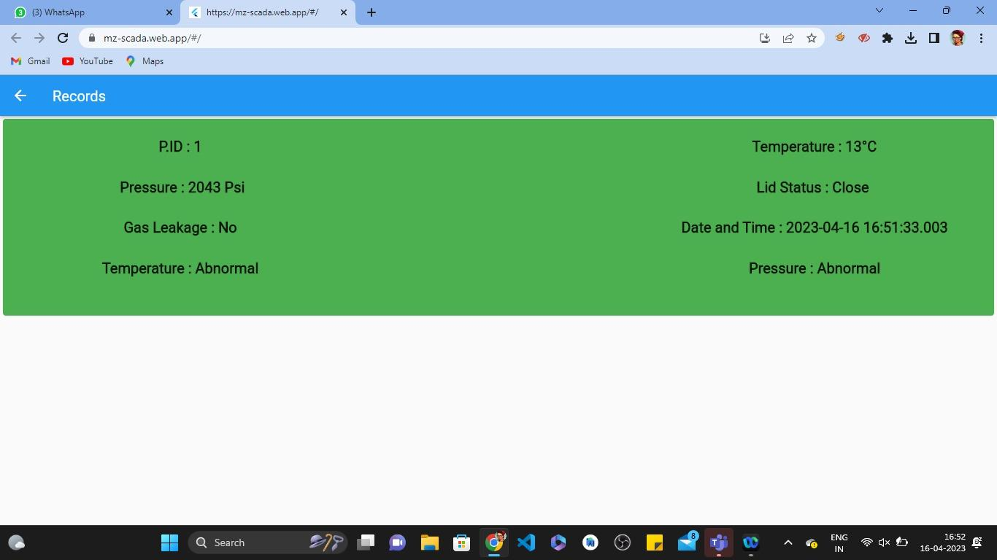
RESULTS - MZ SCADA ALERT LOGS

Slide 16
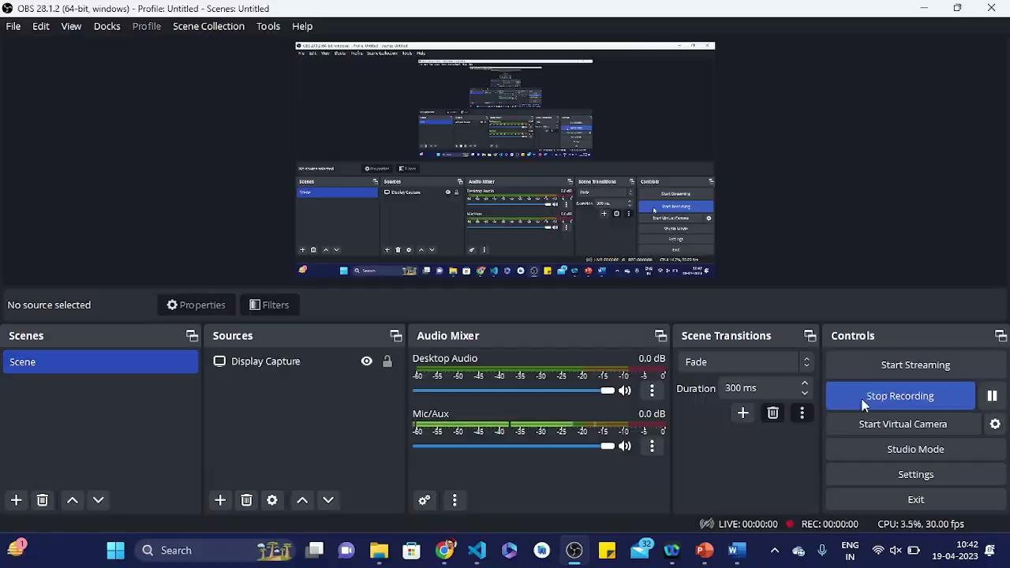
OUTPUT :

Slide 17

MOBILE OUTPUT :
WEBSITE LINK :
https://mz-scada.web.app/#/

Slide 18
CODE IMPLEMENTATION
import 'package:flutter/material.dart’;
import 'dashboard.dart’;
import 'dashboard_phone.dart';class response extends StatefulWidget
{
const response({super.key});
@override State<response> createState() => _responseState();
}
class _responseState extends State<response>
{
@override Widget build(BuildContext context)
{
return LayoutBuilder(builder: (context, constraints)
{
if (constraints.maxWidth < 700)
{ return mobile(context);
} // else if (constraints.maxWidth < 1250)
{ // return Desktop(context); //
} else
{
return Desktop(context);
} });
}
Widget mobile(BuildContext context)
{ return pdash();
} Widget Desktop(BuildContext context)
{ return dash();
}
}

Slide 19
CONCLUSION & FUTURE ENHANCEMENT
Visualization of pressure & temperature.
Graphs of alerts.
Alert logs (Real time alerts).
Avoids hazards.
No man power.
Keep the environment clean.

Slide 20
FUTURE ENHANCEMENT
WIDENING :WSN(Wireless sensor network)nodes
AUTOMATION : Underground Drainage Monitoring System (UDMS)
Platform structure
Flexibility and reusability
Optimization of the sensor nodes
Optimization of the communication
Error recovery

Slide 21
REFERENCES
Lazarescu, M.T., "Design of a WSN Platform for Long- Term Environmental Monitoring for IoT Applications," Emerging and Selected Topics in Circuits and Systems, IEEE Journal on , vol.3, no.1, pp.45,54, March 2023
Kelly, S.D.T.; Suryadevara, N.K.; Mukhopadhyay, S.C., "Towards the Implementation of IoT for Environmental Condition Monitoring in Homes," Sensors Journal, IEEE, vol.13, no.10, pp.3846, 3853, Oct. 2021.
I. Akyildiz, W. Su, Y. Sankarasubramanian, E. Cayirci, “A Survey on Sensor Networks”, IEEE Communications Magazines, August 2022.
A. OzanBicen and Ozgur B. Akan and V. CagriGungor, “Spectrum-Aware and Cognitive Sensor Networks for Smart Grid Applications,” IEEE Communications Magazine, No. 5pp. 158-165. 2022
J. Guevara, F. Barrero, E. Vargas, J. Becerra, S. Toral, “Environmental wireless sensor network for road traffic applications,” IET Intell.Transp. Syst., Vol. 6, Iss. 2, pp. 177–186, 2021

Slide 22
REFERENCES
M. T. Lazarescu, “Design of a WSN platform for long- term environmental monitoring for IoT Applications,” IEEE Journal Emerging and Selected Topics in Circuits and System, vol. 3, No.1, pp.45-54, 2023.
ZigBee Alliance, Zigbee 2007 Specification, 2020.
Romer, K.; Mattern, F., "The design space of wireless sensor networks," Wireless Communications, IEEE, vol.11, no.6, pp.54,61, Dec. 2020
M. Koriehs, M. Kohvakka, J. Suhonen, P. Hamline, M. Hinokinin, and T. D. hemline, Ultra-Low Energy Wireless Sensor Networks in Practice. New York: Wiley, 2021.
Chang, A.Y.; Chang-Sung Yu; Sheng-Chi Lin; Yin-Yih Chang; Pei-Chi Ho, Identification and Positioning of the Underground Manhole with RFID Ground Tag," INC, IMS and IDC, 2009. NCM '09. Fifth International Joint Conference on vol no.pp.1899, 1903 25-27 Aug.2021 doi:10.1109/NCM.2021.306

Slide 23
Any Queries ???

Slide 24
THANK YOU !!!

